Slide 1
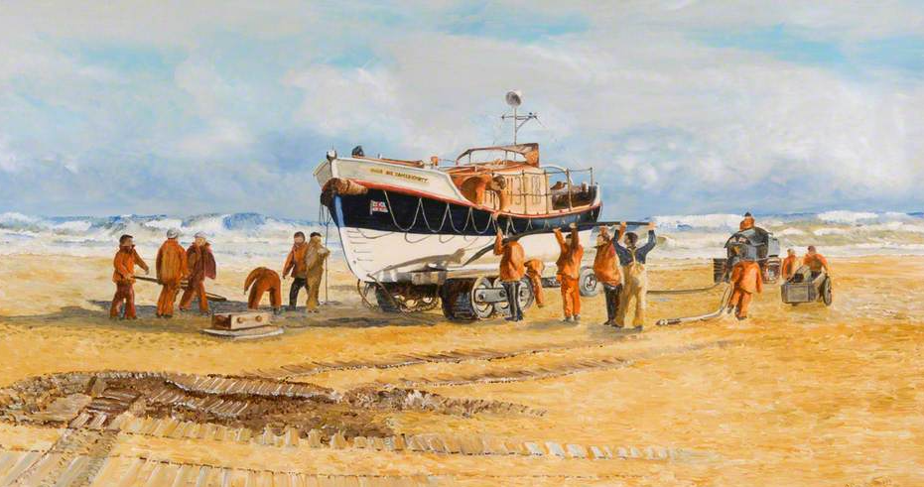
This is a lifeboat. It is a boat that is ready to go out and save people who are in danger in the water. Hundreds of brave volunteers around the country sail lifeboats. These are ordinary men and women who are willing to be called out to help other people.
What is the weather like? What clues can you see?
What do you think the boat is for?
What are the people wearing? Who do you think they are?
Describe the boat.
If you were in the painting what could you see, smell and hear?
What can you see in this painting?

Slide 2
Watch this video showing modern day life boats. How many different boats can you see and look how different they are to the one in the painting.
Two and a half minutes with the RNLI
Now watch this video about the RNLI and Grace Darling.
Grace Darling – Topic pack
Look at how brave all of the women were.
Do you think you could be that brave?
Choice of tasks:
Colour in the life boats on the colouring pages. Draw the boats crew on board.
Using junk from around the house, make your own life boat. Think carefully about the material. How can you make it float?
Look at or print the ‘spot the dangers’ poster. Can you find all the dangerous thins that are happening at the coast that might cause life guards or the coast guard to help?

